Slide 1








Executive Summary
This Slide will be used only for Senior Leadership teams
Overview
Opportunity Qualification
Description
Customer Areas of Concern
The Google Cloud Migration Strategy will help the IT performance and maturity across the customers system. The team consists of highly experienced individuals who work alongside the customer, to rapidly assess the IT estate and provide a roadmap of actionable recommendations for short & longer-term strategy. Our unique approach utilises a proven framework to understand customers challenges, translate insights into roadmaps and prioritises bundles of work in alignment with the customers value streams.
<<We need to add customer areas of concern here>>
Investors are concerned about the ability to scale and contain costs with our current Infrastructure.
Also concerned that a competitor could use a public cloud platform to offset their up-front investment and free them to focus on developing better features.
Need to remediate operational issues and identify current gaps
Legacy systems and aging assets
Fragmented service delivery models
Need to adapt to workforce cultural shift – move from manual processes & systems to automated
Need for data centralization and real-time insights
Under-performing, directionless programs
What do we deliver?
Business Benefits
Actionable recommendations to remediate and transform the customers IT estate
Years of delivery experience, proprietary tooling and hands-on know-how
A roadmap of opportunities
Enables customer data driven decision making
Operational stability and maturity
Minimise cost and drive growth
Protect and reduce risk
Accelerate transformation and strategy
Build change & continuous improvement
Proof Points
Why Google Cloud?
Success stories
Where else have we done this before?
Delivery-Led experienced team of professionals with proven hands-on experience.
Speed to deliver value is weeks not months to baseline and identify opportunities.
Vendor and technology agnostic with strong existing partner eco-system relationships.
Proven methodology, tools and best practices
Holistic approach leveraging global capability and cross-industry learnings from customer base.
<<We need to add previous customer success stories here>>
\<< Add the successful customer logo here>>

Slide 2





Google Cloud Architecture Framework
The Google cloud Architecture framework provides a rapid assessment of current IT performance, to identify pragmatic activities and actions and provide a roadmap for long term strategy. Our unique approach considers systems design, operational excellence, security, privacy, and compliance, reliability, cost optimization, and performance optimization. We use sophisticated assessment method to identify and solve issues which dramatically improve service levels, reduce major incidents, improve team culture, and reduce operational costs. Our framework is Vendor, Technology and Industry agnostic, we have the skills and expertise on-demand regardless of your heritage or environment.
Existing Environment, Technical Requirement , Business Requirement & Proposed Solution

Slide 3






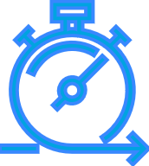


Putting it together Ways to reach from where we are now→ future mode of operations
Existing Environment
Technical Requirement
Business Requirement
Proposed
Solution
Framework
Traditional Application
Legacy Infrastructure
Know the Infrastructure Composition
Usage and Capacity
Access, Security concerns
Scalability Needs
Social Media Presence
Implement an automation Front end and VPC
Implement a continuous deployment process for deploying applications to the on-premises data center or cloud
A SQL Database is required with Memory Store
Support multiple private connections between the production data center and cloud environment
Build a reliable and reproducible environment
Improve security by defining and adhering to a set of security and identity and access management (IAM) best practices for cloud
Improve business agility and speed of innovation Use Memory store features
DEVOPS is required for business testing
Analyze and optimize architecture for performance in the cloud
A 3 Tier Architecture
Use Front end Client Interface – Cloud Run
Cloud VPC
Cloud SQL will be database
Use Redis for Memory store
Devops – CI/CD – Use Jenkins from Marketplace
SCOPE

Slide 4
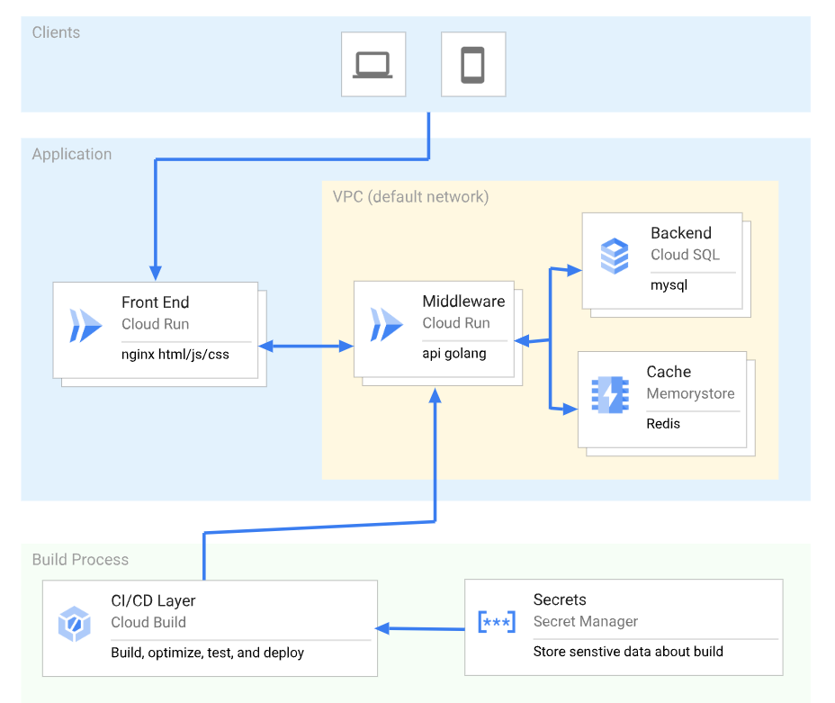
Three Tier Application Architecture
Refer Coding Document for Execution

Slide 5
Backend Database - MySQL - Cloud SQL Caching - Redis - Cloud Memorystore Middleware/API Container hosted API - Golang - Cloud Run Front End/UI Container hosted UI - Nginx + HTML/JS/CSS Cloud Run Deployment Continuous Deployment - Cloud Build Secret Management - Cloud Secret Manager

Slide 6
Migration or Adoption Strategy
Jan’23: Liaise with Account Technical Lead to agree proposal / delivery to customer
Mar’23: Start Implementation and complete
May’23: Verify, test and document solution for standardised delivery to any environment
ü
Perform POC. On-demand access given to the customer along with offer to collaborate on further development.
Proven delivery in two customer estates. Testing and development ongoing.
Liaising with vendors and partners

Slide 7
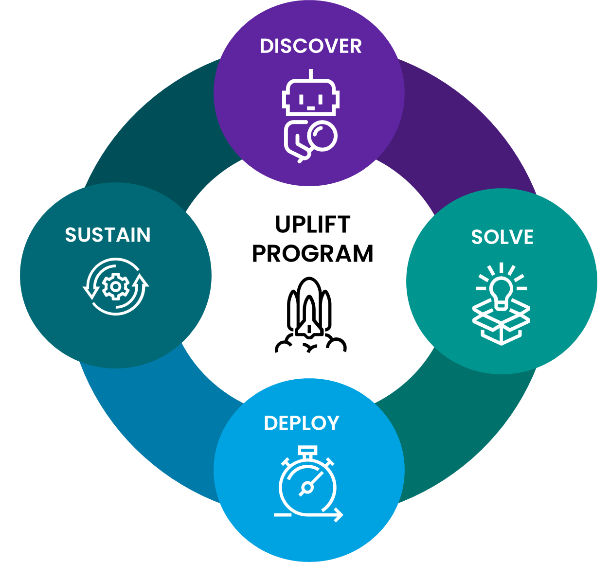




Uplift: Engagement Model
By combining a proven uplift methodologies, we will partner with you to identify and prioritise activities that unlock value and deliver tangible results.
PARTNERS
CUSTOMERS
TOOLS, DATA & REPORTING
PLATFORMS, PRODUCTS, & SERVICES
Access to current extensive network of partners, industry experts, education institutes and global reach.
Bringing cross-industry learnings from our extensive customer base to accelerate transformation.
Leveraging our talent and tools to enrich business decision making.
Supports transformation while keeping your business safe.
UPLIFT PROGRAM
Unlock business value and drive maturity across your business.

Slide 8
Migration Phase – Use this for Migrating data
1.Kick Off
2.Solution Design
3.Create RFS
4.Awaiting Delivery from Provisioning
7. Activation /Migration
5.Handover to Client
6.Hand back to Client
8. Decom
9. Close

Slide 9
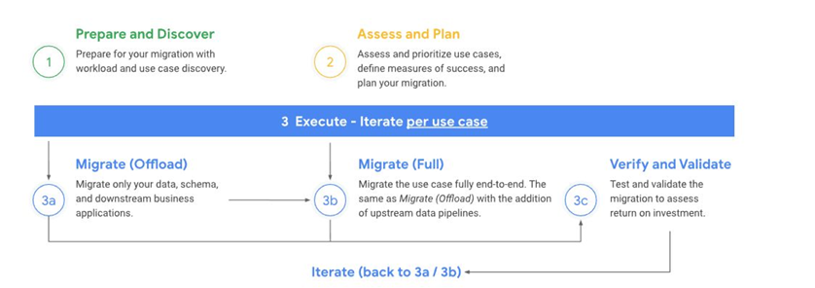

Slide 10
Coding

